Slide 1
Introduction to Media Computation
Barb Ericson
Georgia Institute of Technology
May 2006

Slide 2
Learning Goals
Understand at a conceptual level
  What is media computation?
  How does color vision work?
  How can you make colors with red, green, and blue light?
  How do digital cameras and computer displays work?
  What is a pixel?
  How can you show a picture from a file in Java?

Slide 3
What is Media Computation?
Processing
  picture elements
  sound fragments
  movie frames
  Text files and HTML pages
The speed and storage capacity of modern computers makes this possible
  Even for beginning students just learning to program

Slide 4
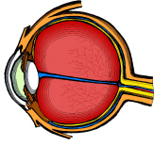
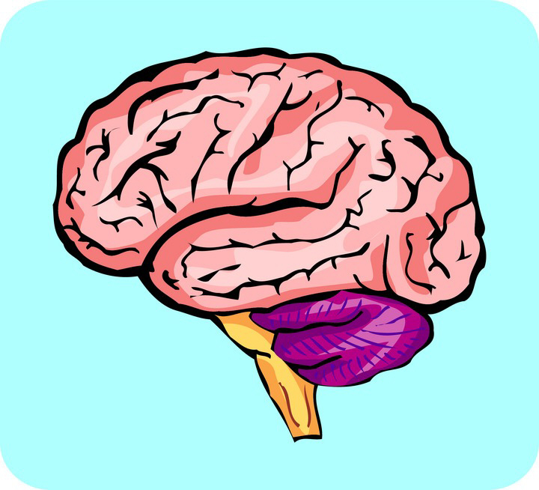
How Does Color Vision Work?
Our eyes and brain work together to make sense of what we see
The cones in our eyes are what allow us to see in color
The rods allow us to see black, white, and shades of gray
Our cones are sensitive to red, green, and blue light
  All other colors are combinations of these
Notes:
See http://www.cyh.com/cyh/kids/detail.html?topic_id=1484 and http://library.thinkquest.org/C001464/cgi-bin/view.cgi?show_item=eye_function_slight for an explanation of vision.
See http://www.phys.ufl.edu/~avery/course/3400/vision/rod_cone_microscope.gif for a picture of rods and cones.
See http://www.harmsy.freeuk.com/headless.html and http://www.exploratorium.edu/seeing/exhibits/index.html for some optical illusions.
See http://library.thinkquest.org/C001464/cgi-bin/main.cgi? For

Slide 5
Red, Green and Blue Light
White light is a combination of red, green, and blue
  Full intensity red, green, and blue combined
Black is the absence of all light
  No red, green or blue light
All other colors are combinations
  Of red, green, and blue
  Of different intensities
Notes:
See http://lite.bu.edu/lite1/color/mix/mixmac.html for an applet that lets you mix colors.
See http://www.sciencenetlinks.com/tools.cfm?DocID=41&Grade=6-8 for an explanation of why paint primary colors are different that light primary colors.

Slide 6
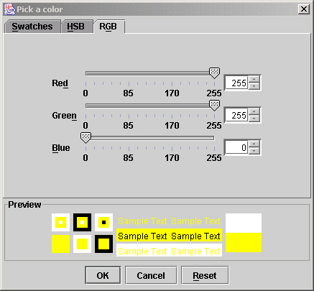
Color Exercise
Start DrJava
  In the interactions pane type
  ColorChooser.pickAColor();
  Click on the RGB tab and move the sliders to change the intensity of red, green, and blue
  Make white, black, red, blue, green, yellow, violet, and orange
Notes:
Can you figure out why the colors range from 0 to 255? If I tell you that each color is stored in 8 bits does that help?
Hold up a CD and change the angle of it with the light. What colors do you see?
Do you think pickAColor is an object method or a class method? How can you tell?

Slide 7
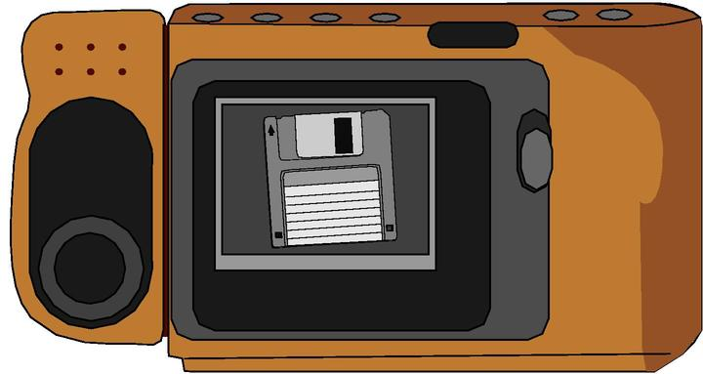
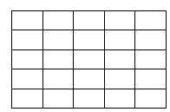
How do Digital Cameras Work?
There are red, green, and blue filters that capture the amount of each color at a position
  A part of a grid
There are many positions
  picture element or pixel
  640 x 480 is low resolution
  1600 x 1200 is high resolution
The more pixels the better the picture
  Can enlarge it without it looking grainy
Notes:
For more information on how digital camera work see http://travel.howstuffworks.com/digital-camera.htm.

Slide 8
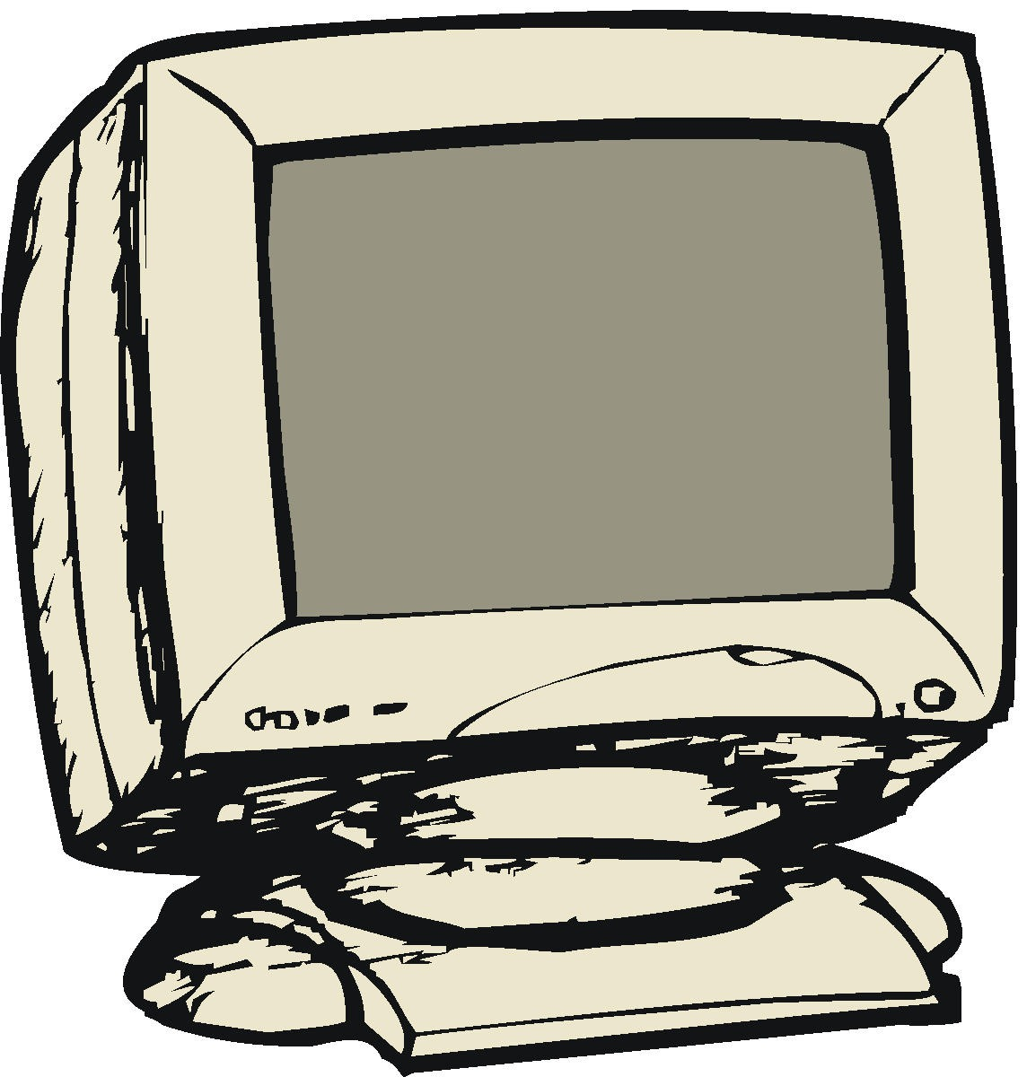

How do Computer Displays Work?
A display has pixels (picture elements)
Each pixel has a red, green, and blue component
Combinations of red, green, and blue give the resulting color
  Black is 0 red, 0 green and 0 blue
  White is 255 red, 255 green, 255 blue
Notes:
See http://computer.howstuffworks.com/monitor.htm for more information on how computer monitors work.
See http://entertainment.howstuffworks.com/tv3.htm for information on CRT devices.
See http://electronics.howstuffworks.com/lcd.htm for information on LCD devices.
Colors are often digitized as 24 bits per pixel, 8 bits for red, 8 for green, and 8 for blue. Thus the intensity of the red can be from 0 to 255 since 8 bits are used.

Slide 9
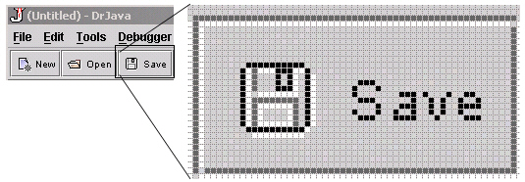

Pictures are made up of Pixels
Digital cameras record light at pixels
Monitors display pictures using pixels
Our limited vision acuity helps us to see the discrete pixels as a smooth picture
  If we blow up the picture we can see the pixels

Slide 10
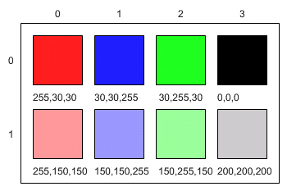
Digital Pictures
Capture the intensity of the red, green, and blue colors at each pixel
Stored as a bunch of numbers
  8 bits for red, 8 bits for green, 8 bits for blue
  Need nearly 1 million bytes to store a 640 x 480 picture
  Need 3 million bytes to store an image from a 1 megapixel (million pixel) camera
Displayed as red, green, and blue colors on the computer display
  Lots of them close together
  Our brain sees a smooth color image

Slide 11
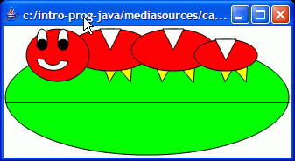
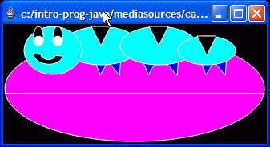
Getting Started
We will start with modifying and creating pictures
  Changing colors in the picture
After pictures we will work with sounds
  Modifying volume, pitch, reversing, etc

Slide 12
The Picture Class
To make doing media manipulation easier
  We have created a set of classes for you to use
    Picture, ColorChooser, FileChooser, Pixel, etc
These are not part of the Java language
  But were created at Georgia Tech
You should have added the directory that has these classes to your classpath
  Back when we worked with Turtles
  This tells Java where to find the classes

Slide 13
Creating a Picture Object
To create a picture object from a file
  We need the full name of the file
    We can use FilePicker.pickAFile() to get that
      Class method that returns the full file name as a String
  We need to ask the Picture class to create the picture object
    Using the data from the specified file
      new Picture(fileName)
  If we want to see the picture we have created
    We will ask the picture object to show itself

Slide 14
Naming each Piece
First let’s pick a file name and save a reference to the resulting String object in a variable called fileName
  String fileName = FileChooser.pickAFile();
Next, let’s create a Picture object and save a reference to it in a variable called pictureObj
  Picture pictureObj = new Picture(fileName);
Now send the show() message to the picture object
  pictureObj.show();
Notes:
Notice that we don’t need to declare a variable each time we use it. We only need to give the type the first time we mention the name. In fact, the code won’t compile if you try to declare two variables with the same name.

Slide 15
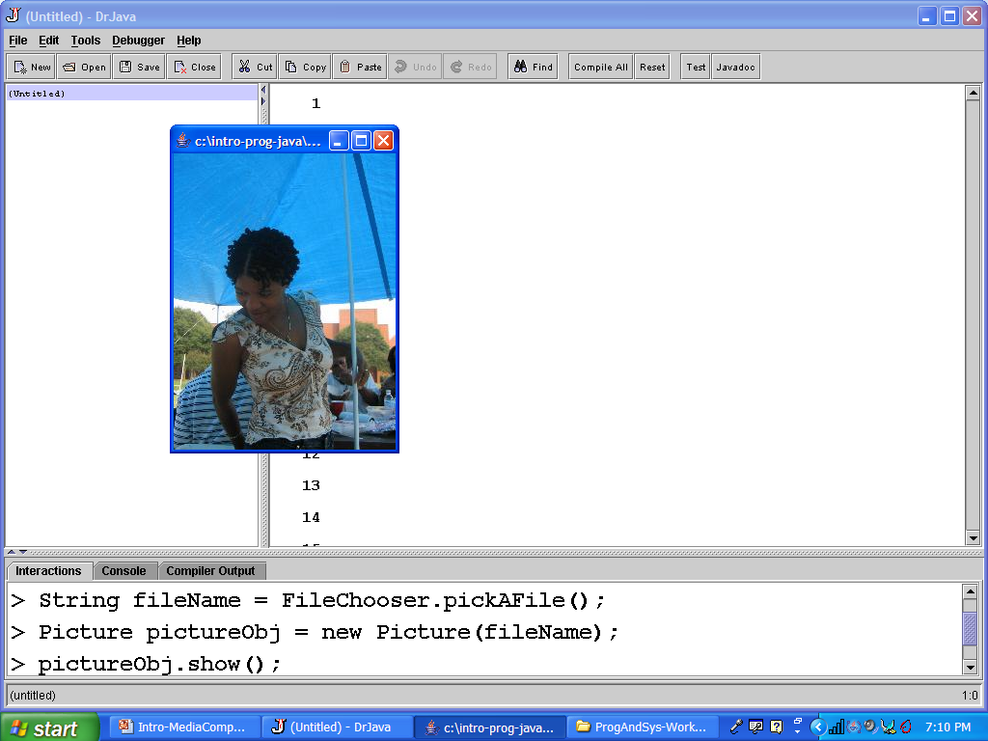
Naming Each Part
Notes:
This is showing the picture tammy.jpg. Tammy is a Computer Science student at Georgia Tech.

Slide 16
Doing it all at Once
You can create a picture object
  by passing it the result of using the FileChooser to pick a file
  and then tell that picture object to show itself
  All in one line
  new Picture(FileChooser.pickAFile()).show()
  But then you don’t have a way to refer to the file or picture again.

Slide 17
Show Picture Exercise
Try both ways of creating a picture object and showing it.
  new Picture(FileChooser.pickAFile()).show()
  And do each piece one step at a time naming the result of each method
    String fileName = FileChooser.pickAFile();
    System.out.println(fileName);
    Picture picture = new Picture(fileName);
    System.out.println(picture);
    picture.show();
Notes:
Use System.out.println(expression) to see the value of the thing referred to by the variable.

Slide 18
Substitution and Evaluation
In programming you can
  Use a literal
    String name = “Barb”;
  Use a variable
    String myName = “Barb”;
    String name2 = myName;
  Use an expression
    String n3 = “Ba” + “rb”;
  Use the result of a method invocation
    String n4 = student1.getName();
Values get substituted for variable names when expressions are evaluated

Slide 19
Summary
Media computation can mean processing millions to billions of bytes
  The speed of modern computers makes media computation possible even for beginners
We see combinations of red, green, and blue light
A pixel is a picture element
Digital pictures store red, green, and blue values from 0 to 255 for each pixel in a picture
You can pick a file, create a picture object, and show it using:
  String file = FileChooser.pickAFile();
  Picture pictObj = new Picture(file);
  pictObj.show();

